Slide 1
Genetic Architecture in Autism Spectrum Disorders
Danny Antaki, Sebat Lab
Biomedical Sciences Graduate Program
University of California, San Diego
Thesis Committee Meeting May 2, 2018

Slide 2
Mini CV
Publications
Brandler, W. M.*, Antaki, D.*, Gujral, M.*, et al. Paternally inherited cis-regulatory structural variants are associated with autism. Science, 2018
Antaki, D., Brandler, W. M., Sebat J. SV²: Accurate structural variation genotyping and de novo mutation detection from whole genomes. Bioinformatics, 2018
Brandler, W. M.*, Antaki, D.*, Gujral, M.*, et al. Frequency and complexity of de novo structural mutation in autism. The American Journal of Human Genetics, 2016
Breuss, M., Kleiber, M., George, R. D., Antaki, D., et al. Quantification of autism recurrence risk by direct assessment of paternal sperm mosaicism. bioRxiv, 2017
Consortium Publications
Chaisson, M. J., et al. Multi-platform​​ discovery​​ of​​ haplotype-resolved structural​​ variation​​ in​​ human​​ genomes. bioRxiv, 2017 (1000 Genomes)
Marshall, C. R., et al. Contribution of copy number variants to schizophrenia from a genome-wide study of 41,321 subjects. Nature Genetics, 2017 (PGC)
Sudmant, P. H., et al. "An integrated map of structural variation in 2,504 human genomes." Nature, 2015 (1000 Genomes)
Posters
SV²: Accurate Structural Variation Genotyping and De Novo Mutation Detection for Whole Genomes. American Society of Human Genetics, Orlando FL 2017
Whole Genome Sequencing Identifies Complex and Balanced De Novo Structural Variation in Autism. World Congress of Psychiatric Genetics, Toronto Canada 2015
Whole Genome Sequencing Identifies Complex and Balanced De Novo Structural Variation in Autism. American Society of Human Genetics, Baltimore MD 2015
Discovery, validation and genotyping of CNVs by analysis of genome sequence and microarray. American Society of Human Genetics, San Diego CA 2014
Training Programs
Genetics Training Program 2014-2017 NIH predoctoral training grant T32 GM008666

Slide 3
Aims
Refine Structural Variant (SV) calling in whole genome sequences (WGS)
SV²: genotyping SVs with machine learning
Assay the burden of de novo SV in Autism Spectrum Disorders (ASD)
WGS offers optimal resolution compared to other methods
Interrogate the role of rare inherited variants in ASD
Identifying genetic risk stratified by parent of origin

Slide 4
Rationale for Structural Variants
Classes of Sequence Mutations
SNP: 1bp
INDEL: 2bp-49bp
SV: >50bp
Reference
GATCGATC
GAGCGATC
GAT--CGATC
GAGAG-GATC
Mutation
Functional impact
Potentially more damaging
False Discovery Rate
SV <10kb
Enriched for false positives
SVs are more likely to elicit a functional change but detection carries the cost of a high FDR
Notes:
Example objectives
At the end of this lesson, you will be able to:
Save files to the team Web server.
Move files to different locations on the team Web server.
Share files on the team Web server.

Slide 5
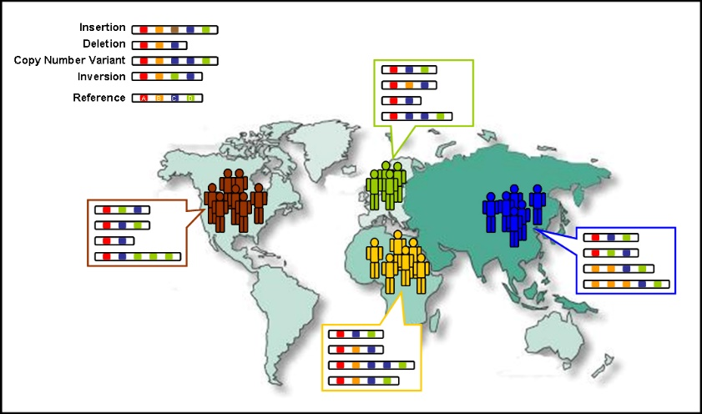
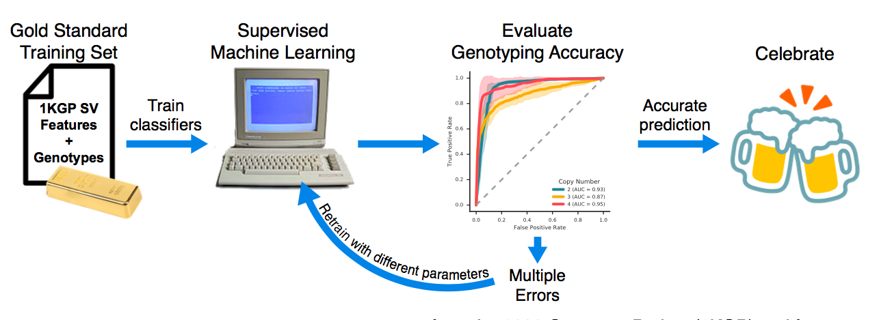
Detecting genotyping errors with machine learning
Training set: 1000 Genomes
SVs from phase 3 release
High coverage WGS (n=27), Low coverage WGS (n=2,494)
Homozygous Deletion: 0 copies
Heterozygous Deletion: 1 copy
Homozygous neutral : 2 copies
Heterozygous Duplication : 3 copies
Homozygous Duplication : 4 copies
Notes:
Example objectives
At the end of this lesson, you will be able to:
Save files to the team Web server.
Move files to different locations on the team Web server.
Share files on the team Web server.

Slide 6
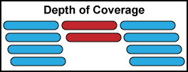
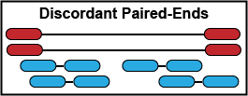
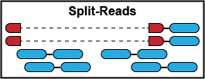
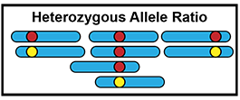
Features of SV in Next-Gen Sequencing
Coverage: Number of reads spanning the SV
Discordant Paired-Ends: abnormal insert sizes
Split-Reads: reads that span SV breakpoints
Heterozygous Allele Ratio:
Duplications only

Slide 7
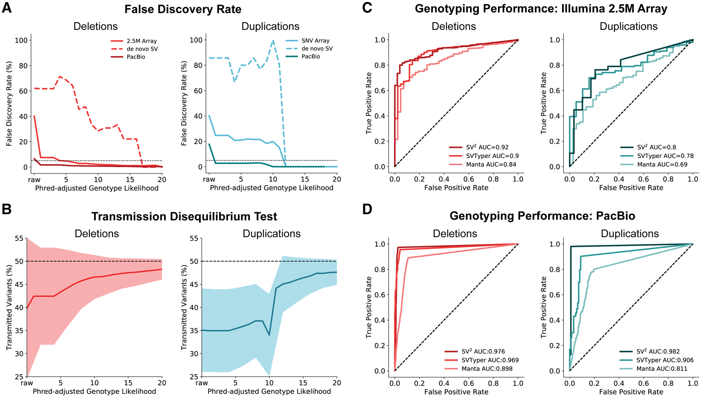
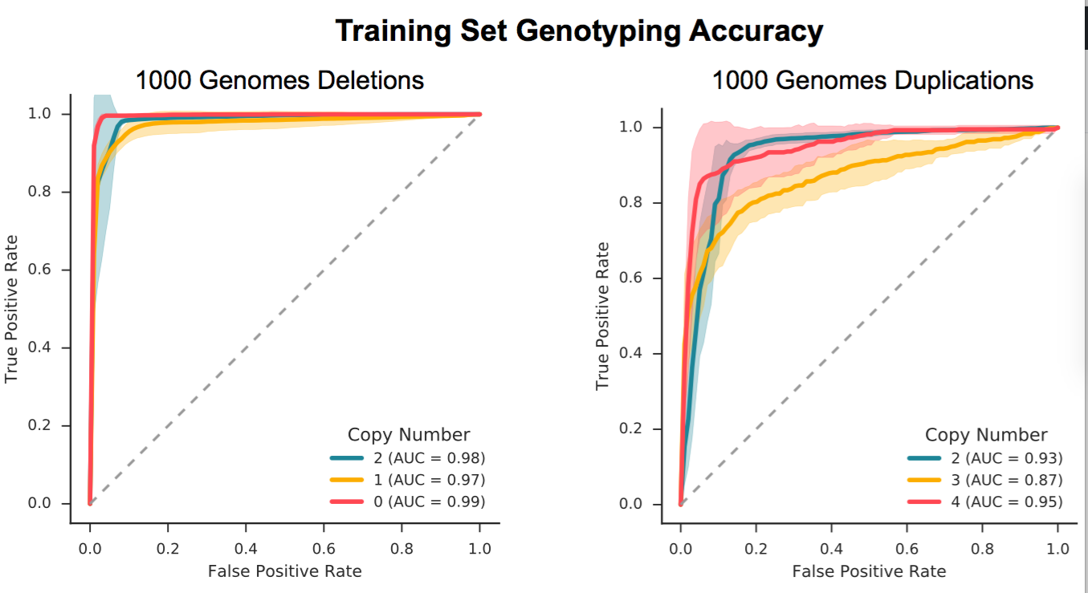
Genotyping Performance
Orthogonal validation:
Microarray: N=57
SVToolkit validated WGS SV genotypes
PacBio SMRT: N=9
Split-reads or CIGAR string
7-fold cross validation of the training set.
Transmission Disequilibrium Test
deviations from the expected transmission rate (50%) are due to genotyping errors
False positives in parents
False negatives in offspring

Slide 8

Comparing SV² to other probabilistic models
SVTyper and Manta utilize paired-end features and probabilistic models
SV² leverages paired-end, coverage, and heterozygous allele ratios and was trained on real data

Slide 9
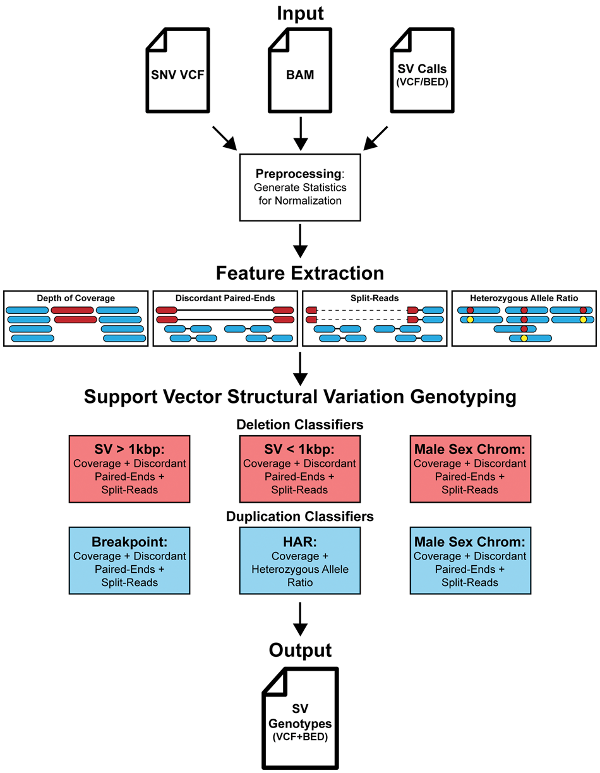

SV² Overview
Low FDR
1.2% Deletions
4.4% Duplications
Low Genotyping Error rates
~48% Transmission Rates
Outperforms other methods
Freely available on github
Python/Cython
github.com/dantaki/SV2
Antaki D. et al. Bioinformatics 2018

Slide 10
Aims
Refine Structural Variant (SV) calling in whole genome sequences (WGS)
SV²: genotyping SVs with machine learning
Assay the burden of de novo SV in Autism Spectrum Disorders (ASD)
WGS offers optimal resolution compared to other methods
Interrogate the role of rare inherited variants in ASD
Identifying genetic risk stratified by parent of origin

Slide 11
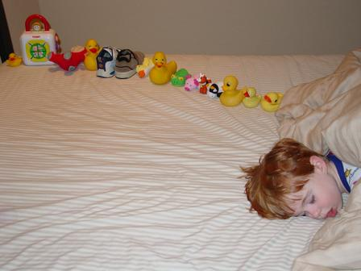
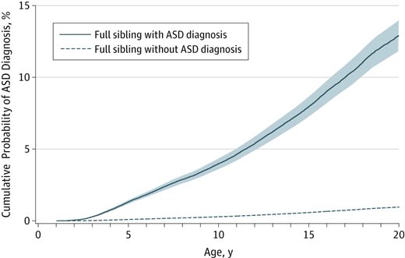
Autism is a heterogeneous neurodevelopmental disorder
Impaired social interaction and restricted behavior
1% Prevalence, 4:1 Male:Female
Sporadic or familial
Siblings have increased risk
Genetic liability is significant
MZ twin concordance 30-99% (0.6-0.8 heritability)
Wikipedia Commons
Sandin, Sven, et al. Jama 2014
Notes:
How presentation will benefit audience: Adult learners are more interested in a subject if they know how or why it is important to them.
Presenter’s level of expertise in the subject: Briefly state your credentials in this area, or explain why participants should listen to you.

Slide 12
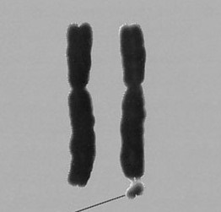
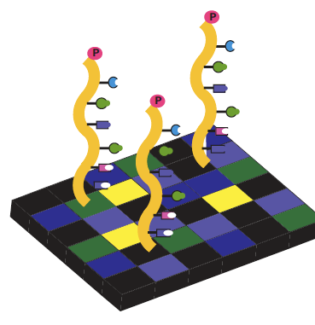
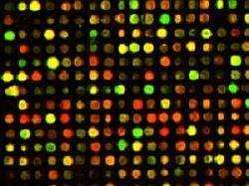
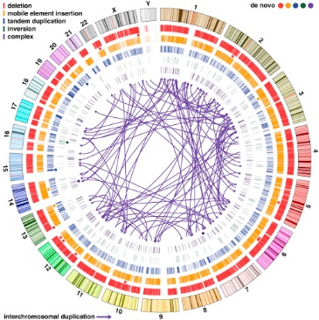
Exome studies found loss of function and missense SNPs+INDELs (1-50bp)
First genetic associations were
microscopic structural changes
(>10Mb)
1960’S
1970’S
1980’S
1990’S
2000’S
2010’S
Microarrarys found sub-microscopic structural changes
(100kb-10Mb)
Whole genome sequencing resolved complex de novo structural changes (50bp-10Mb)
Notes:
How presentation will benefit audience: Adult learners are more interested in a subject if they know how or why it is important to them.
Presenter’s level of expertise in the subject: Briefly state your credentials in this area, or explain why participants should listen to you.

Slide 13
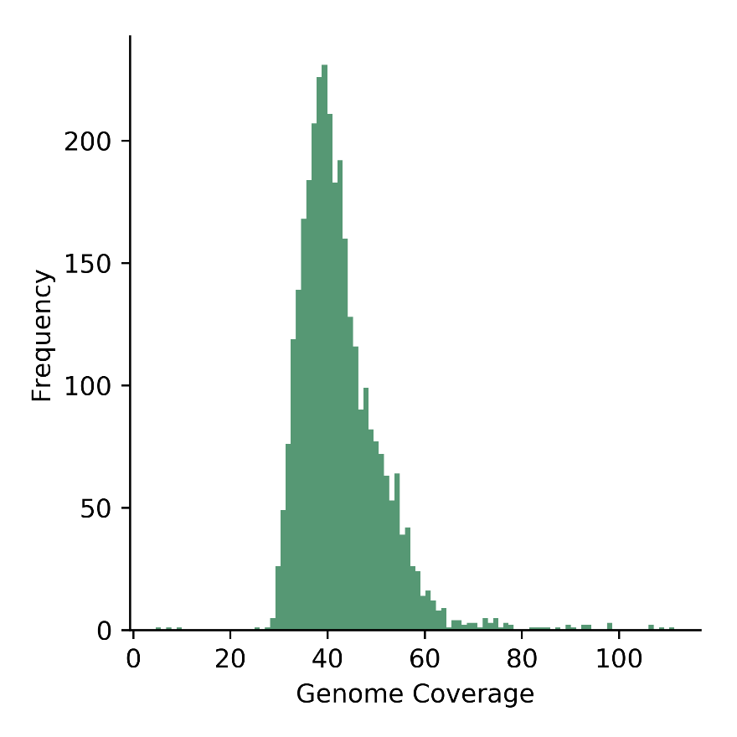
WGS in 3,169 whole genomes
829 families
880 ASD offspring
630 Control siblings
2 Cohorts
REACH: local sources ASD patients (Rady Children’s Hospital, 311 families)
Simons Simplex Consortium (518 families)
Screened negative for de novo LoF or large SV
Illumina paired-end WGS (42x)
SV calling: ForestSV, LUMPY, Manta
Genotype refinement: SV²
^{Filters}
66% overlap to segmental duplications, STRs, unmappable loci, assembly gaps
SV² strict filters for de novo SVs
Notes:
Example objectives
At the end of this lesson, you will be able to:
Save files to the team Web server.
Move files to different locations on the team Web server.
Share files on the team Web server.

Slide 14
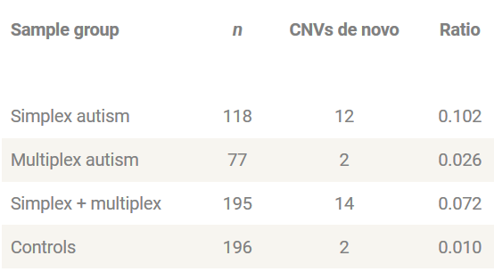
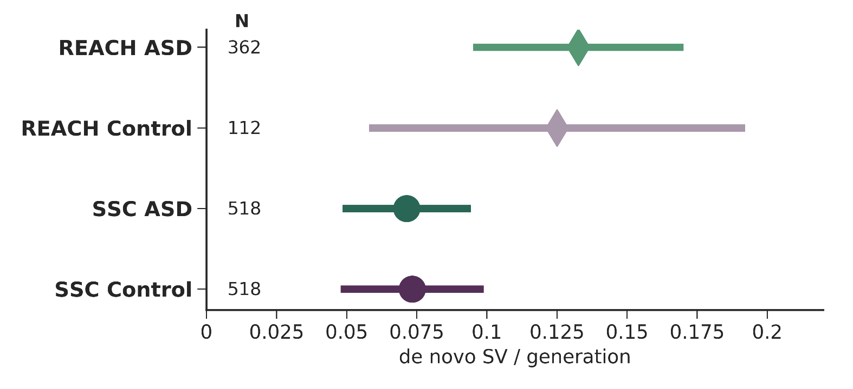
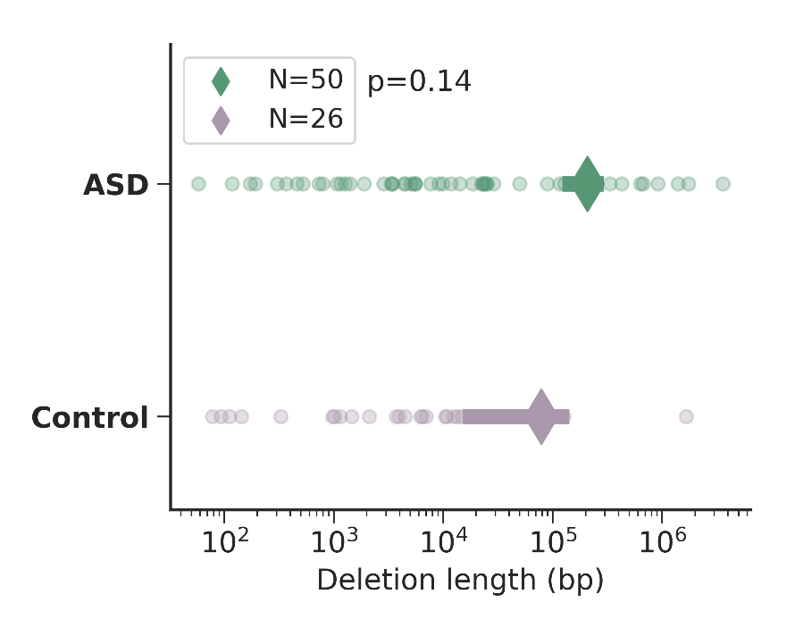
WGS better estimates the de novo SV rate
Previous estimates of de novo SV were limited to microarrays
SV > 20kb
Copy Number Variants
WGS better estimates the de novo rate in controls
SVs 100bp-10kb
Complex and Unbalanced SVs
Sebat J., et al. Science 2007

Slide 15
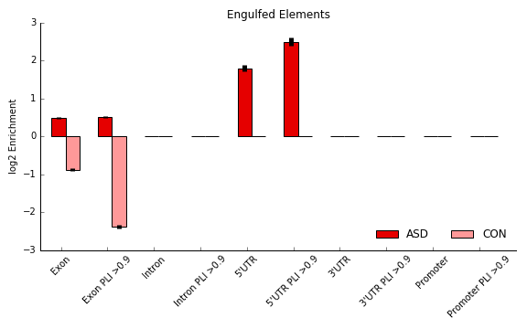
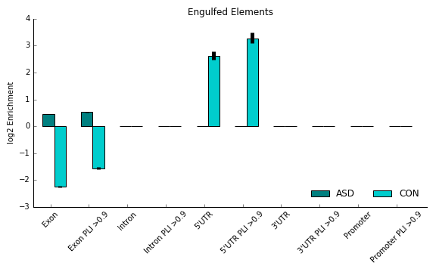
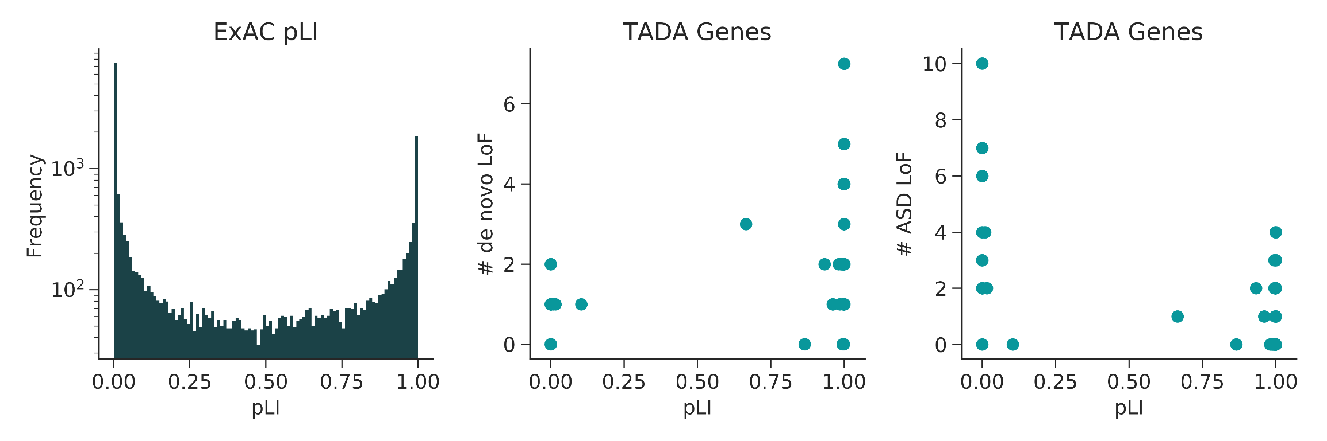
De novo SVs are enriched for exons in ASD
de novo Exon Burden
Deletion Exon Enrichment
Duplication Exon Enrichment
pLI | ASD Rate | Control Rate | Pval
0 | 4.2 | 0.2 | 0.004
0.9 | 1.72 | 0.12 | 0.005
0.99 | 1.03 | 0.09 | 0.01
Functional Constraint
Probability of being loss of function intolerant (pLI)
Measure of haploinsufficiency from observed and expected LoFs in Exomes
Functional Constraint

Slide 16
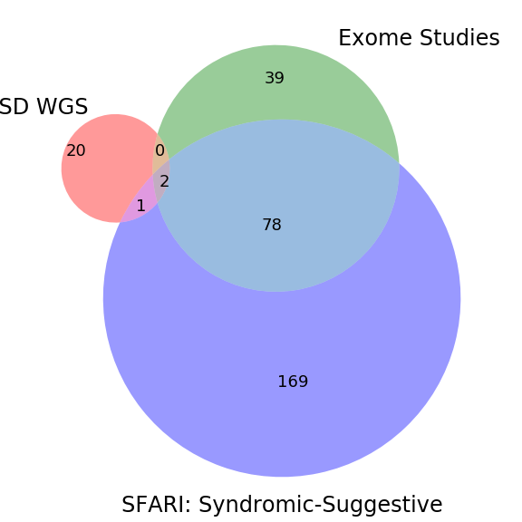
WGS resolves novel single gene hits
20 genes in cases were novel
Previously implicated:
MACROD2,DMD,CHD2
UCSD WGS
Gene | GO Term | Description
CACNG2 | GO:0005245 | voltage-gated calcium channel activity
CANX | GO:0035255 | ionotropic glutamate receptor binding
COL5A2 | GO:1903225 | negative regulation of endodermal cell differentiation
CSMD1 | GO:0042593 | glucose homeostasis
DDX43 | GO:0004004 | ATP-dependent RNA helicase activity
F2R | GO:0051928 | positive regulation of calcium ion transport
FAF1 | GO:0043130 | ubiquitin binding
FGD6 | GO:0043547 | positive regulation of GTPase activity
HERC4 | GO:0042787 | protein ubiquitination
LNPEP | GO:0060395 | SMAD protein signal transduction
PIGL | GO:0006506 | GPI anchor biosynthetic process
PPP1R9A | GO:0060999 | positive regulation of dendritic spine development
SAE1 | GO:0016925 | protein sumoylation
SH3TC1 | - | -
SLC4A5 | GO:0008509 | anion transmembrane transporter activity
SNX24 | GO:0030659 | cytoplasmic vesicle membrane
TAOK1 | GO:0004702 | receptor signaling protein serine/threonine kinase activity
TESC | GO:0004860 | protein kinase inhibitor activity
UBE3B | GO:0004842 | ubiquitin-protein transferase activity
ZNF462 | GO:0003677 | DNA binding

Slide 17
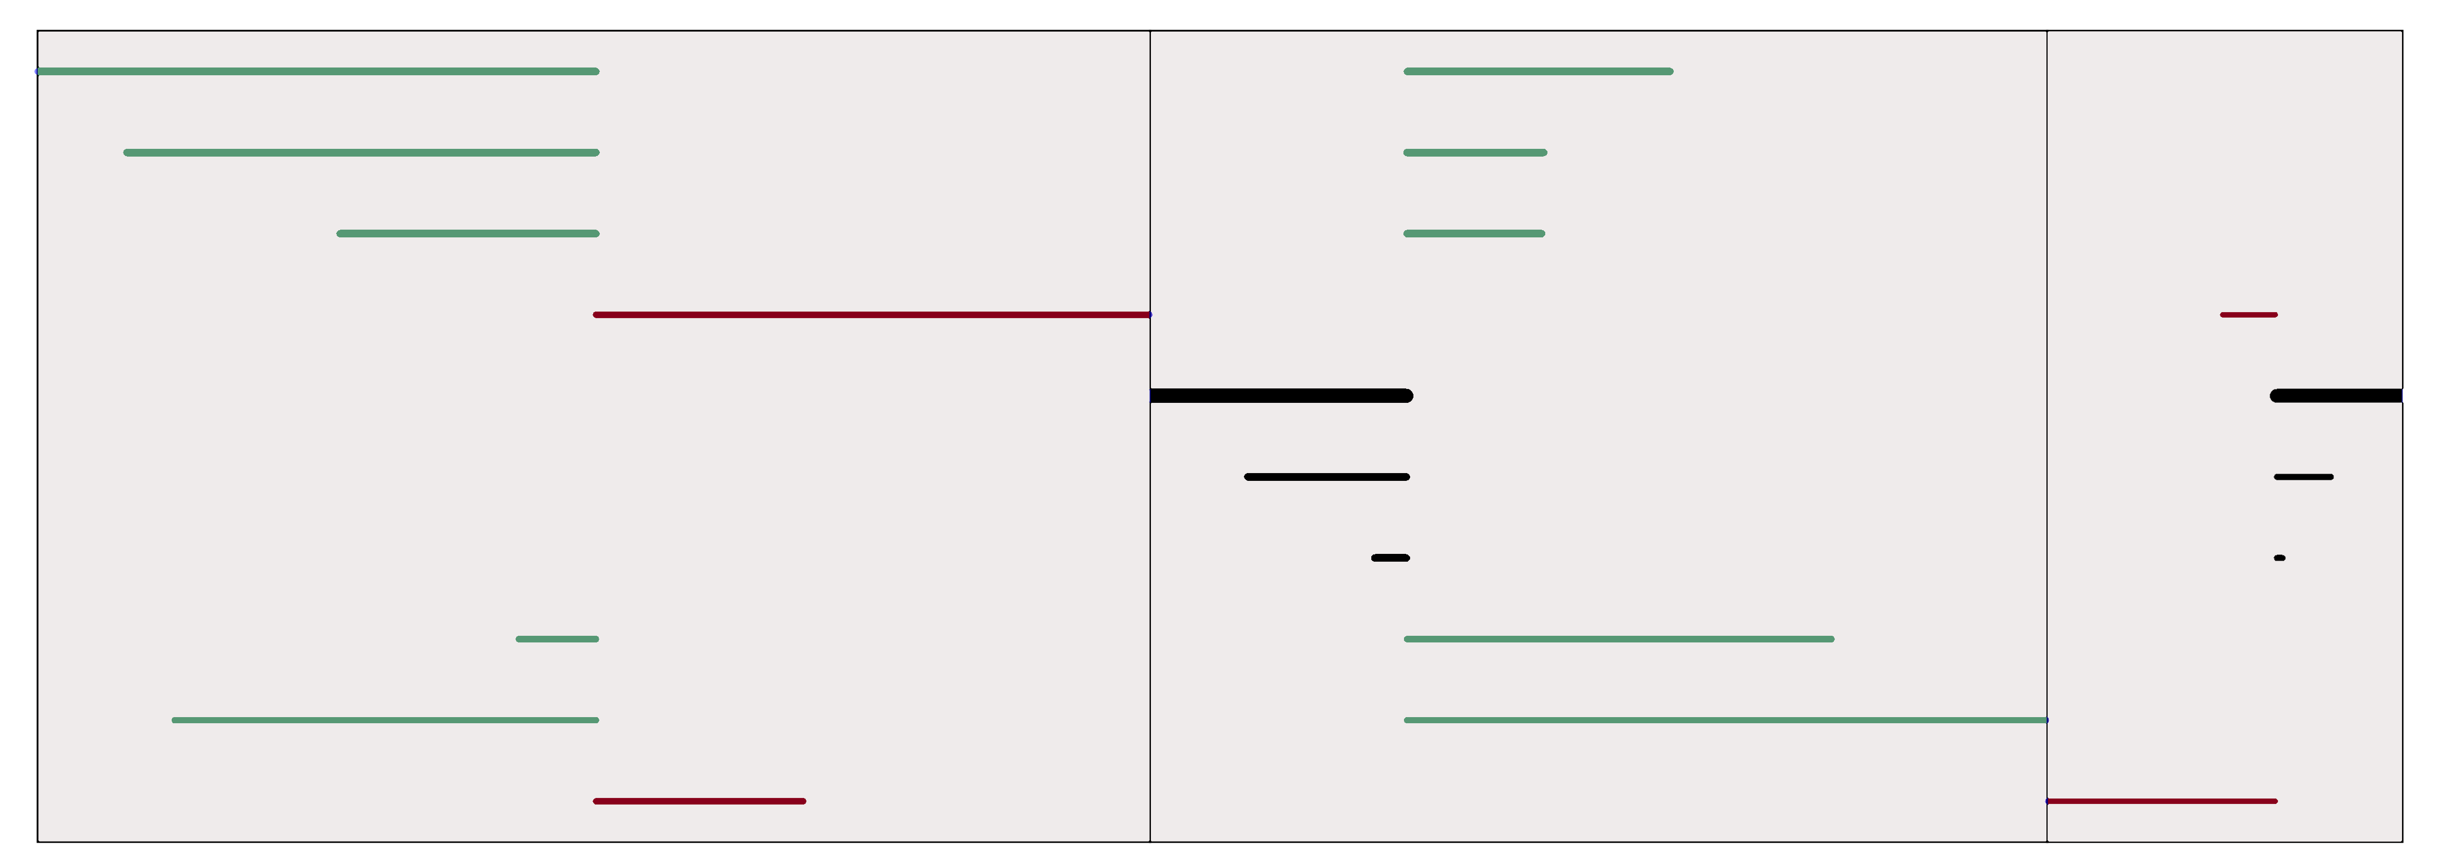
Identifying Complex and Unbalanced de novo SV
WGS can identify Insertions, Inversions, and other complex rearrangements
2 INV
8 Complex
32 INS
Oxford Nanopore Reads
chr10:105449191-105459355
chr10:85437965-85469808
chr10:86214094-86239773
ABCD
ACBD
Reference
Query

Slide 18
Aim2 Overview
De novo SV rate is the same for ASD and control
ASD de novo SV are enriched for haploinsufficient exons
WGS can resolve SV better than previous methods
Brandler, W. M.*, Antaki, D.*, Gujral, M.*, et al. Frequency and complexity of de novo structural mutation in autism. The American Journal of Human Genetics, 2016

Slide 19
Aims
Refine Structural Variant (SV) calling in whole genome sequences (WGS)
SV²: genotyping SVs with machine learning
Assay the burden of de novo SV in Autism Spectrum Disorders (ASD)
WGS offers the best resolution
Interrogate the role of rare inherited variants in ASD
Parent of origin effects

Slide 20
Explaining Missing Heritability in Autism
Method
Class of Variant
Limitations
15-25% of cases have a casual variant
~60-100 genes associated with ASD
Cytogentics
Structural variants
>10Mb
What have previous studies missed?
Cis-Regulatory Elements
10kb – 10Mb
Not enough power for common association
Copy Number Variants
Common SNPs
Microarrays
Limited to target.
Imprecise breakpoints
Targeted Sequencing
(Exomes)
Copy Number Variants
SNPs + INDELs

Slide 21
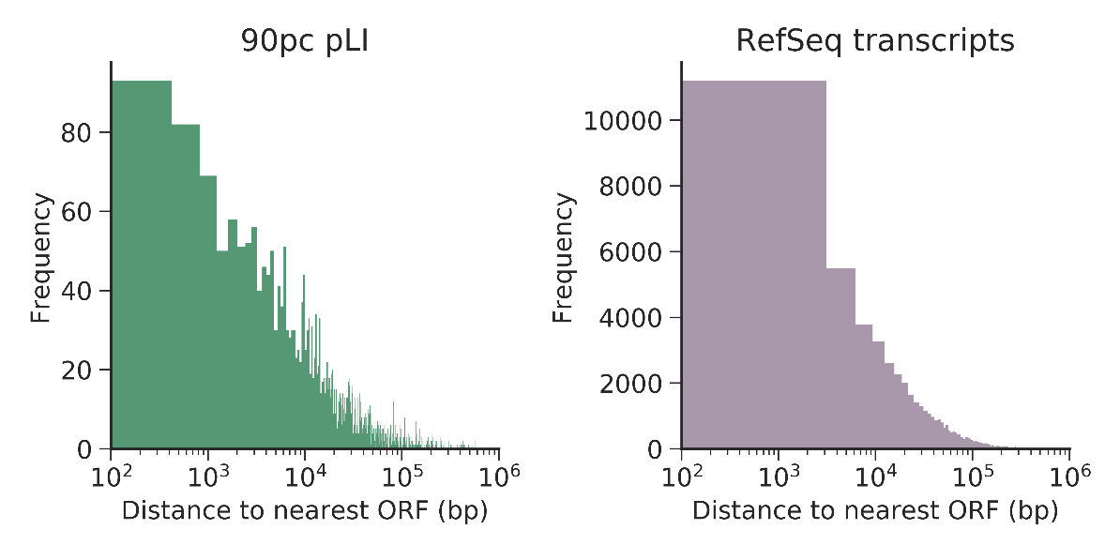
Accounting for Missing Heritability
Exome sequencing neglects cis-regulatory elements
Promoters
UTRs
Transcription Start Sites
*
TSS
Are Cis-Regulatory Structural Variants (CRE-SV) associated with Autism?
*
*
*
Promoter
5’UTR
exon
3’UTR
Microarrays cannot resolve smaller structural variants (50bp-10kb)
37% of non-overlapping open reading frames are within 10kb of each other
No de novo CRE-SV
moderate effect
pLI: probability that a given gene is intolerant to loss of function mutations (ExAC).
Notes:
Lesson descriptions should be brief.

Slide 22
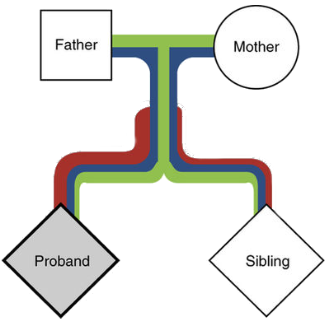

Ascertaining Rare Inherited CRE-SV risk
Group-wise Additive model
Bin variants by functional annotation
Test the transmission rate for binned variants for all offspring in the cohort
Are CRE-SVs transmitted to cases more often than controls?
Transmission Disequilibrium Test (TDT)
Benefits: controls for ancestry and LD
Caveats: genotyping errors confound results
The affected child (proband) inherits more damaging rare mutations (red), than the control sibling.
Adapted from Krumm et al. Nat Gen 2015
Phenotype | Transmitted | Not Transmitted | Transmission Rate
Autism | 2 | 1 | 66%
Control | 1 | 2 | 33%
Notes:
Example objectives
At the end of this lesson, you will be able to:
Save files to the team Web server.
Move files to different locations on the team Web server.
Share files on the team Web server.

Slide 23
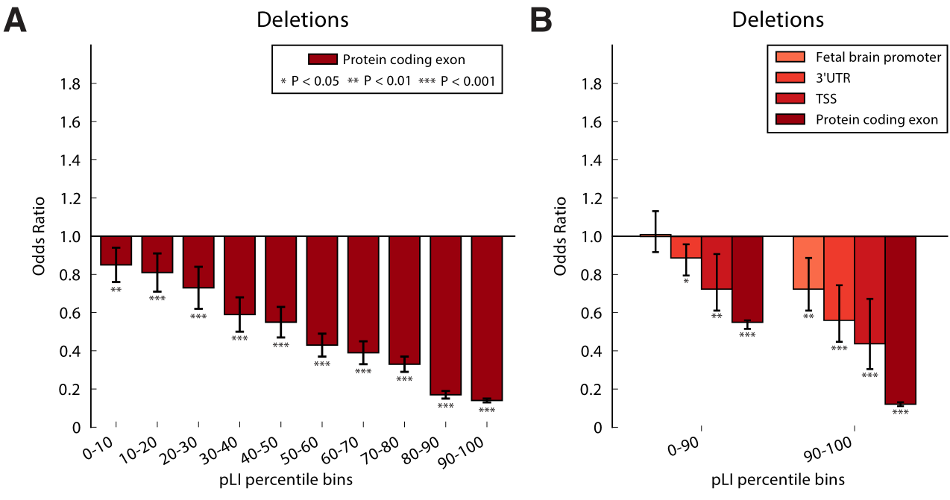
Intolerant Functional Elements are Rarely Deleted
Genes with strong negative selection (pLI >0.9)
Limit to deletions, easier to interpret
Notes:
Example objectives
At the end of this lesson, you will be able to:
Save files to the team Web server.
Move files to different locations on the team Web server.
Share files on the team Web server.

Slide 24
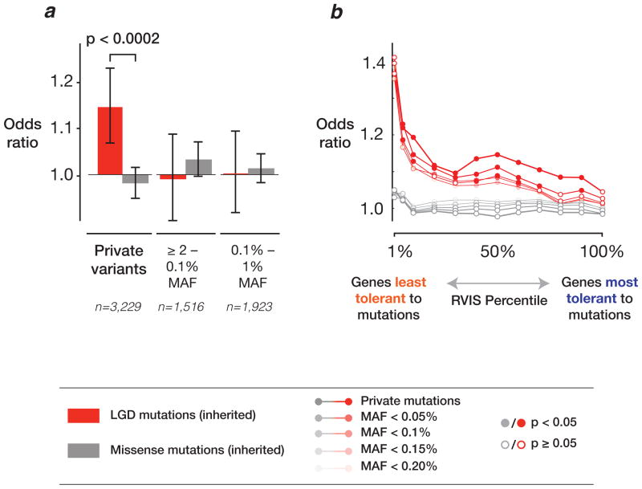
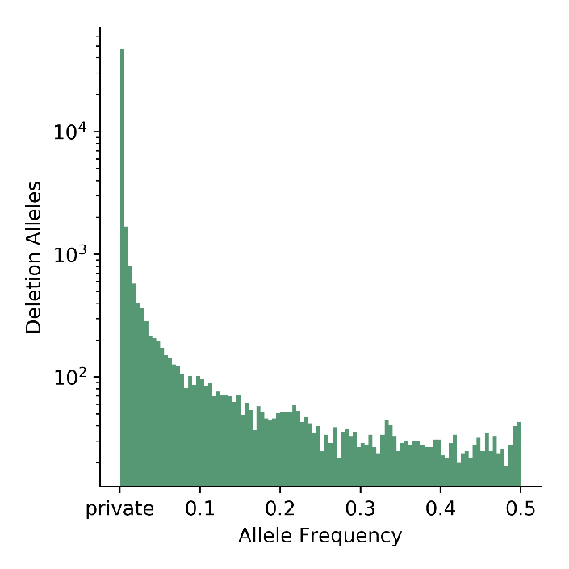
Private Variants are Enriched for Risk
Private variants (singletons) are young mutations
Not enough time for natural selection
LoF
Private loss of function (LoF) SNPs are enriched Autistic children.
Adapted from Krumm et al. Nat Gen 2015
Most variants are rare
More transmission events to test

Slide 25
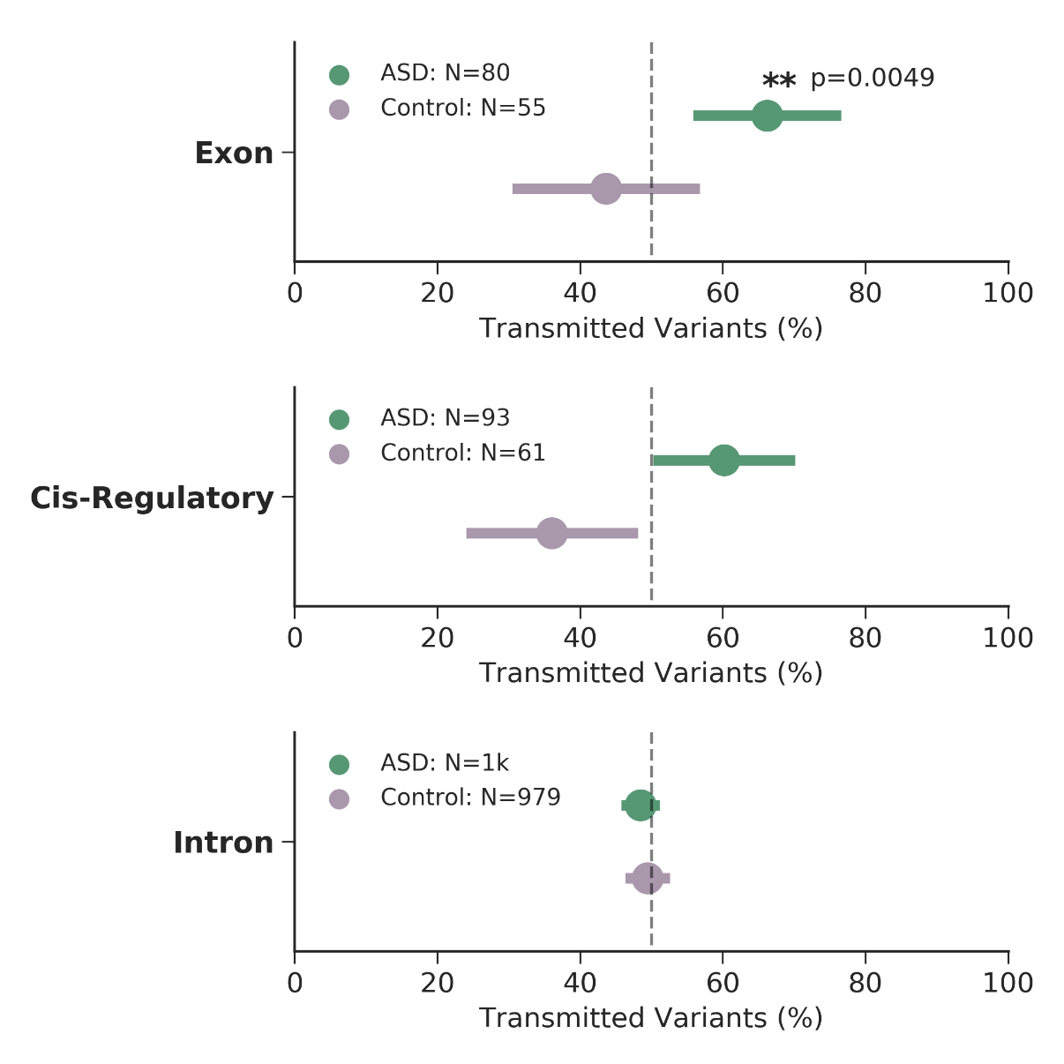

Inheritance of private variants within functionally constrained genes
pLI>0.9908
SVs within introns did not
exhibit transmission bias
Error bars are 95% CI (binomial proportion)
N = number of independent assortment events (transmitted + non-transmitted)
SVs overlapping exons were over-transmitted to cases
Concordant with exome studies
CRE-SVs were slightly over-transmitted to cases
Notes:
Example objectives
At the end of this lesson, you will be able to:
Save files to the team Web server.
Move files to different locations on the team Web server.
Share files on the team Web server.

Slide 26
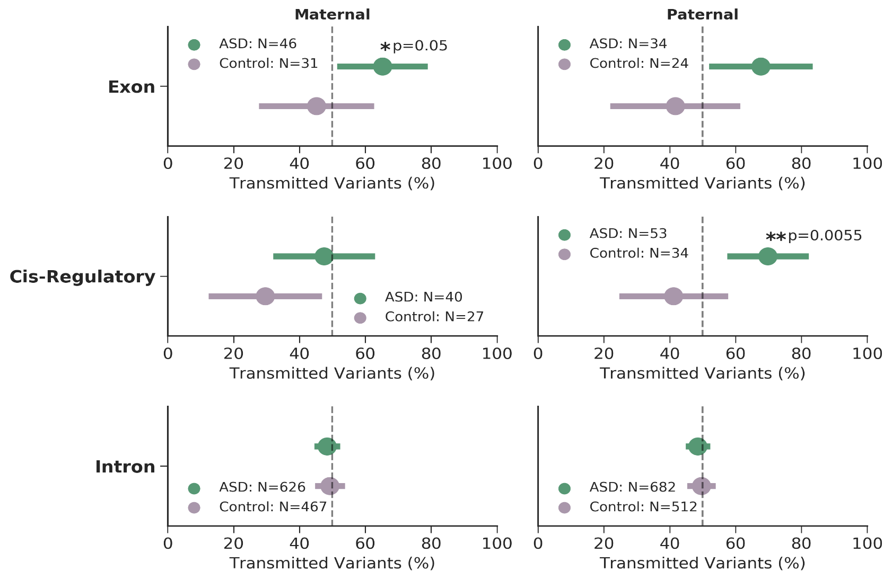
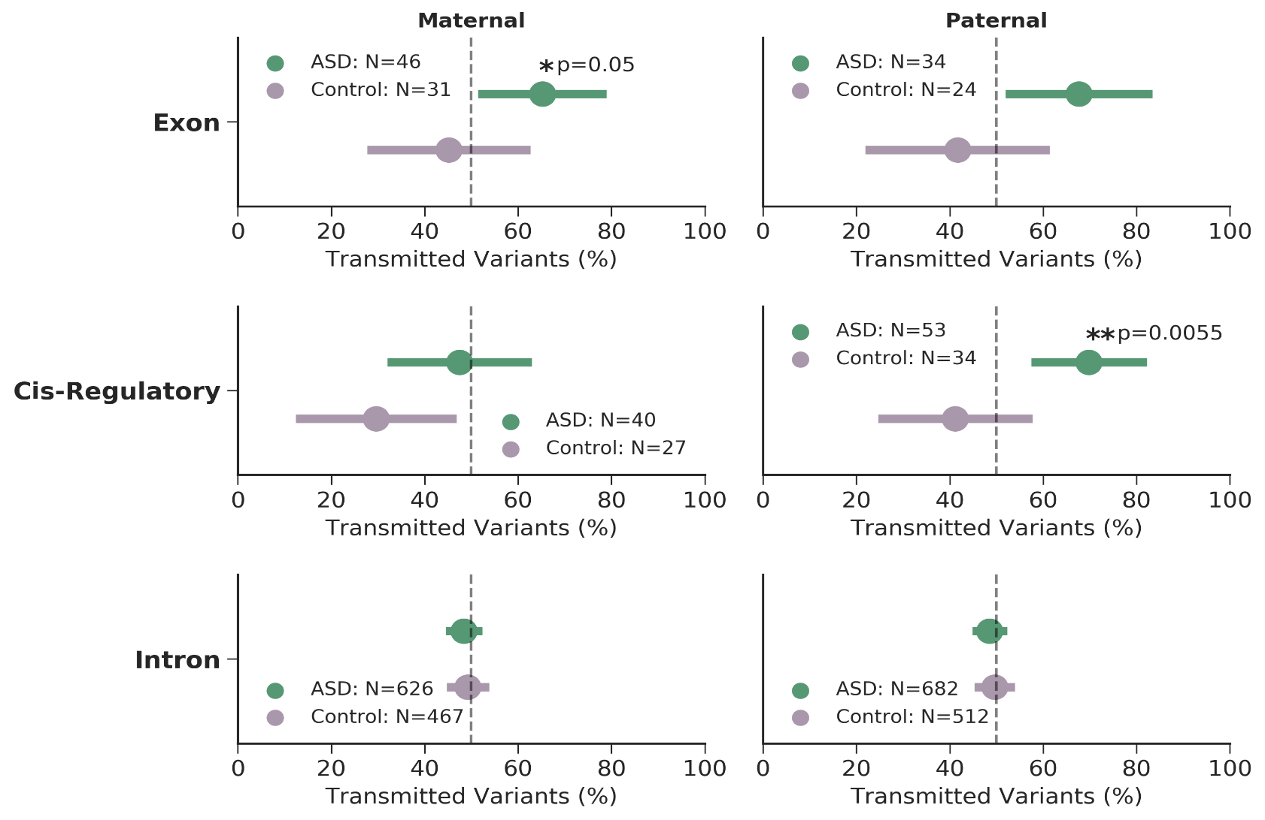

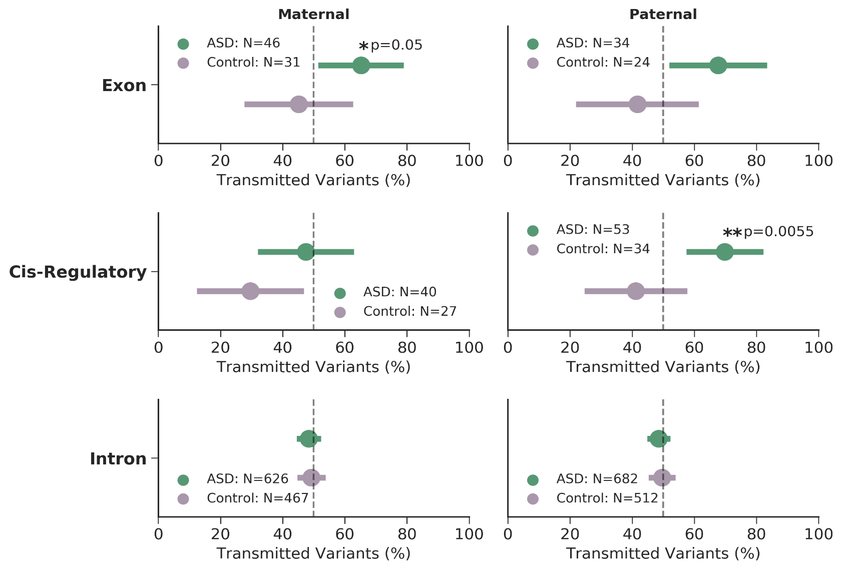
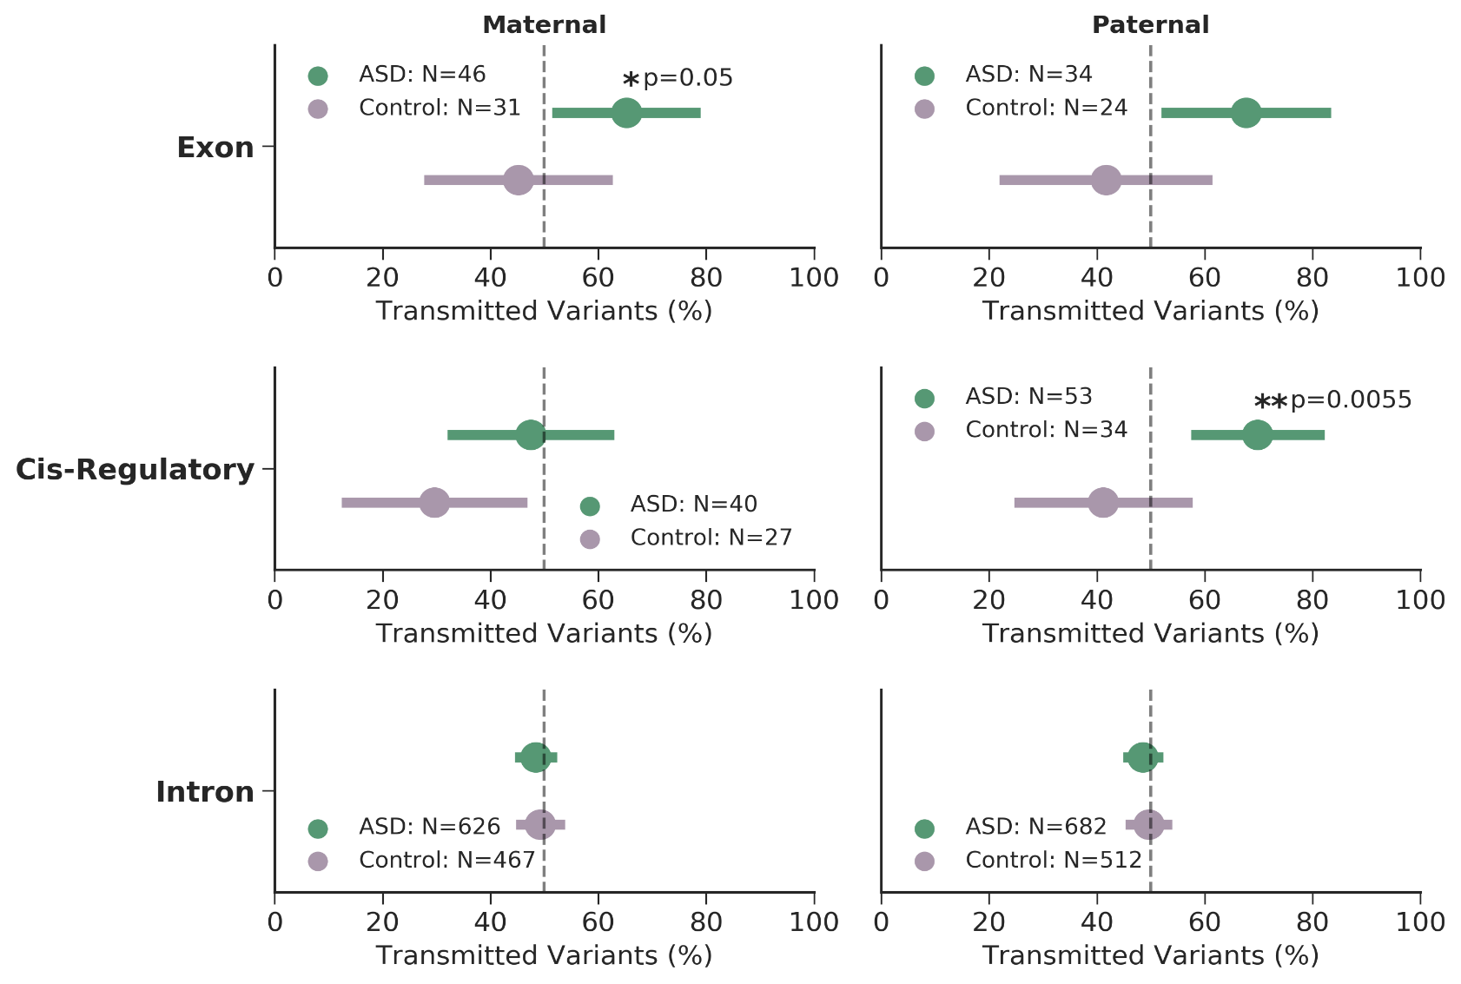
CRE-SVs exhibit a parent of origin effect
pLI>0.9908
No parent of origin effect with private SVs within introns
Mothers over-transmit exonic SVs to cases
Females have higher tolerance for LoF mutations
Fathers over-transmit CRE-SVs to cases
Under-transmission to controls
Notes:
Example objectives
At the end of this lesson, you will be able to:
Save files to the team Web server.
Move files to different locations on the team Web server.
Share files on the team Web server.

Slide 27
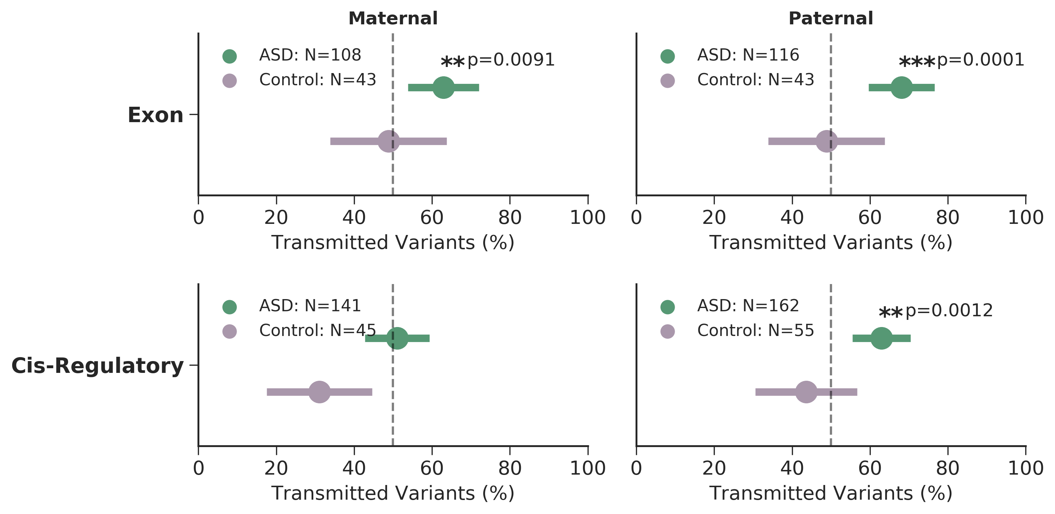
Replicating the initial findings
9,274 whole genomes
2,600 families
2,859 cases
1,214 controls
MSSNG cohort (Stephen Scherer): 3,769
SSC phase 2: 2,336
Exonic SVs are over-transmitted to cases
pLI>0.9908
Rare CRE-SVs exhibit a paternal origin effect
Notes:
Example objectives
At the end of this lesson, you will be able to:
Save files to the team Web server.
Move files to different locations on the team Web server.
Share files on the team Web server.

Slide 28


Overview and future directions
CRE-SVs exhibit a significant paternal origin effect
~0.8% of cases have a paternally inherited CRE-SV
Rare inherited variants thought to contribute ~3-4% to ASD
Autism is more complex than previously thought
Fathers also contribute inherited risk
Bilineal two-hit model
Inherited maternal LoF of large effect
Inherited paternal CRE-SV of moderate effect
Brandler, W.M.*, Antaki, D.*, Gujral, M.*, et al. Paternally inherited cis-regulatory structural variants are associated with autism. Science 2018.

Slide 29

Exploring the Inherited Bilineal Model
REACH + SSC1 + SSC2 + SCC3
SSC phase 4 to 6 processing
Condition on maternal LoF
What is the remaining risk from father?
To sons or daughters?
Test inheritance of rare SNPs, INDELs, and SVs
Functional constraint
pLI (Coding)
CDTS + Ubiquitous Enhancers (Noncoding)

Slide 30
Methodology
WGS in 7,716 individuals
2,005 families
2,059 ASD
1,808 control
Call SNPs , INDELs, SVs
Flag damaging de novo variants
Flag damaging inherited variants
Perform TDT on conditioned trios to ascertain inherited risk
Group variants according to functional constraint

Slide 31
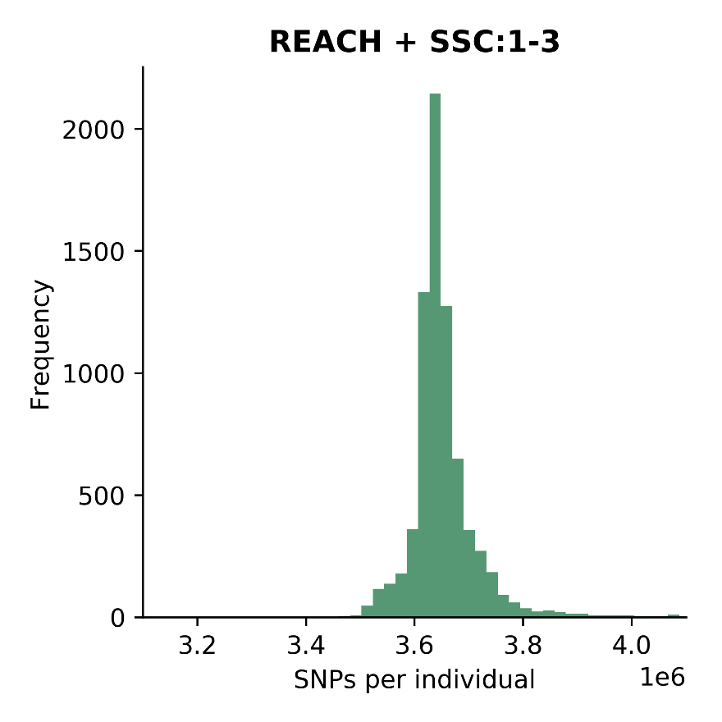
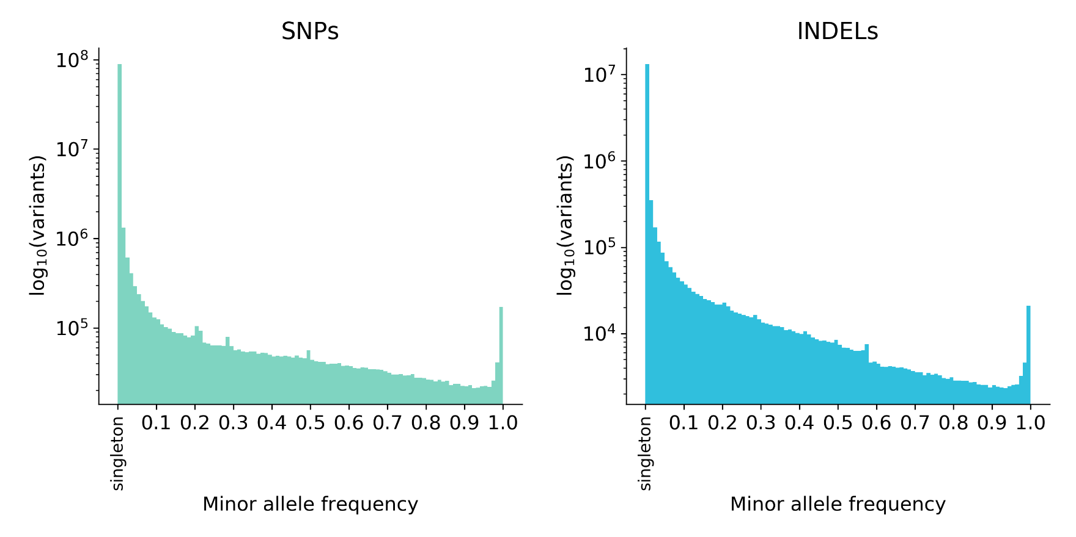
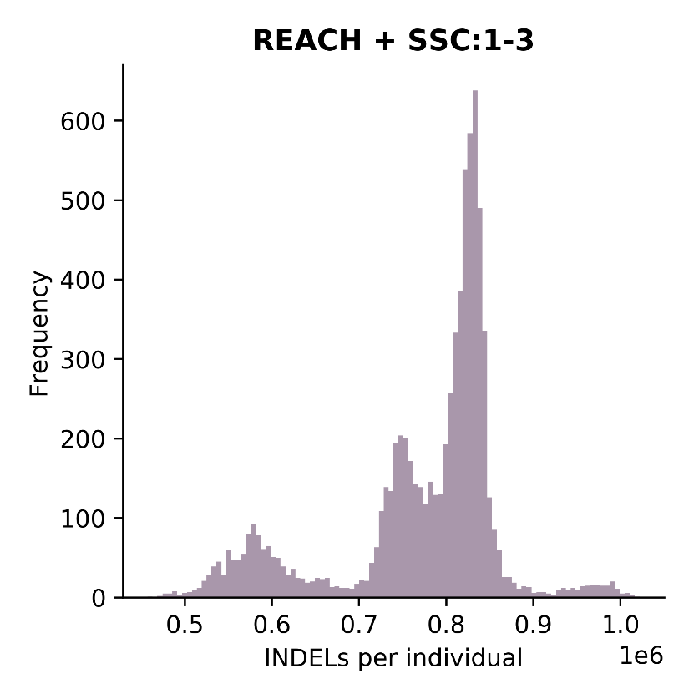
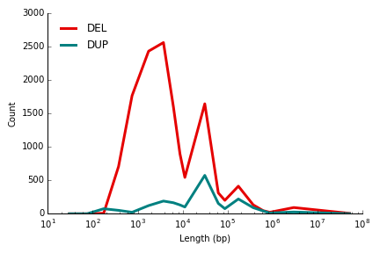
Variant QC
3.6M SNPs per individual
773k INDELs per individual
3.7k SV per individual

Slide 32
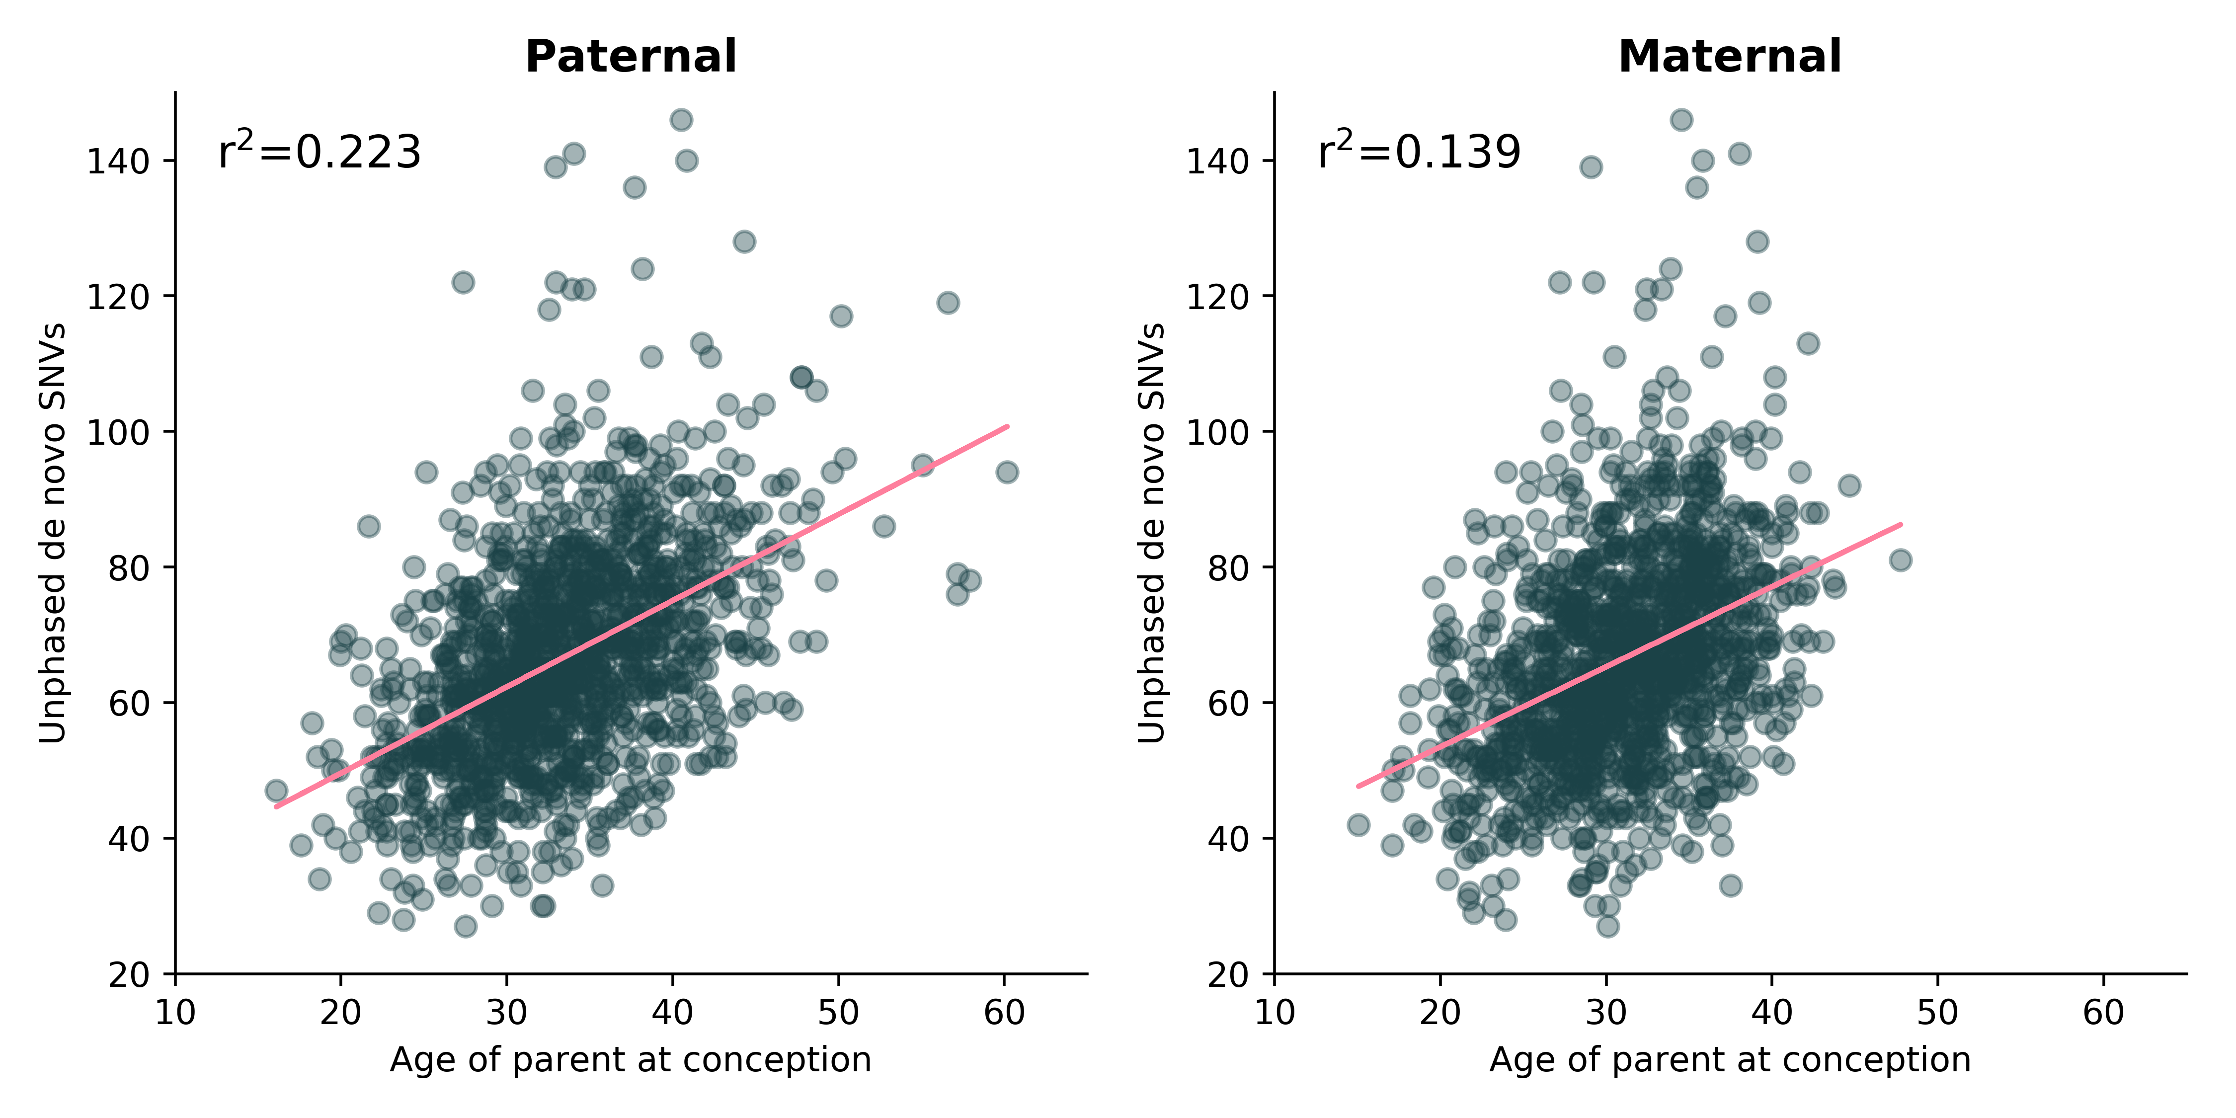
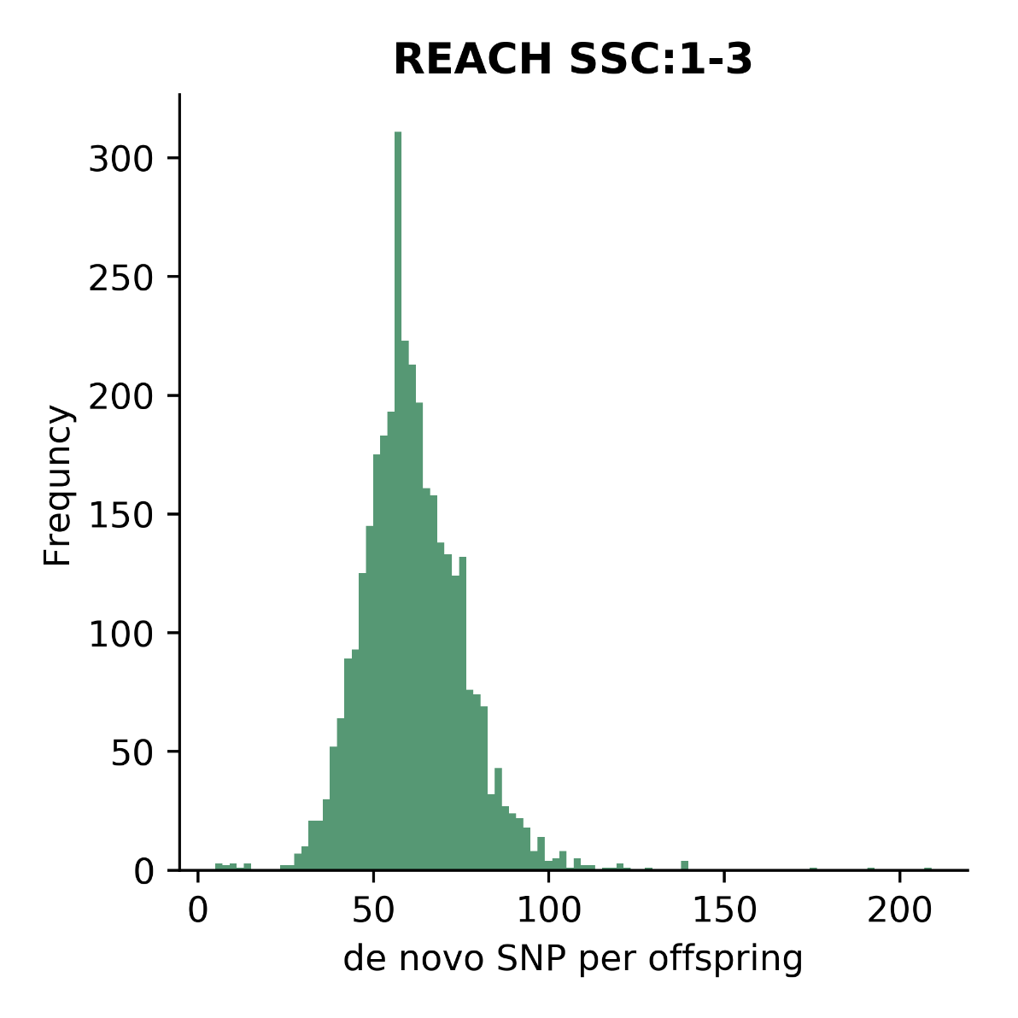
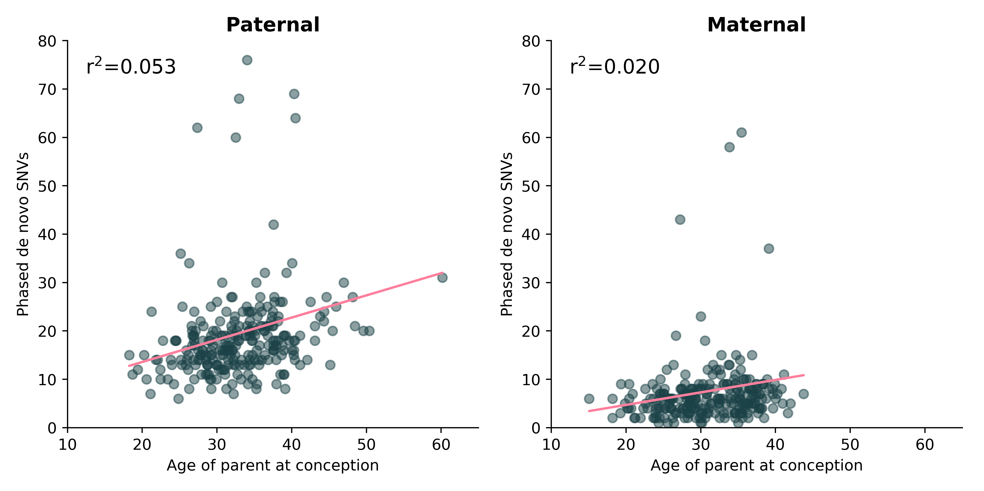
De novo SNP
ForestDNM
Filters
Common variants (>1% AF) 1000 genomes phase 3
Segmental Duplications
0% AF in parents

Slide 33
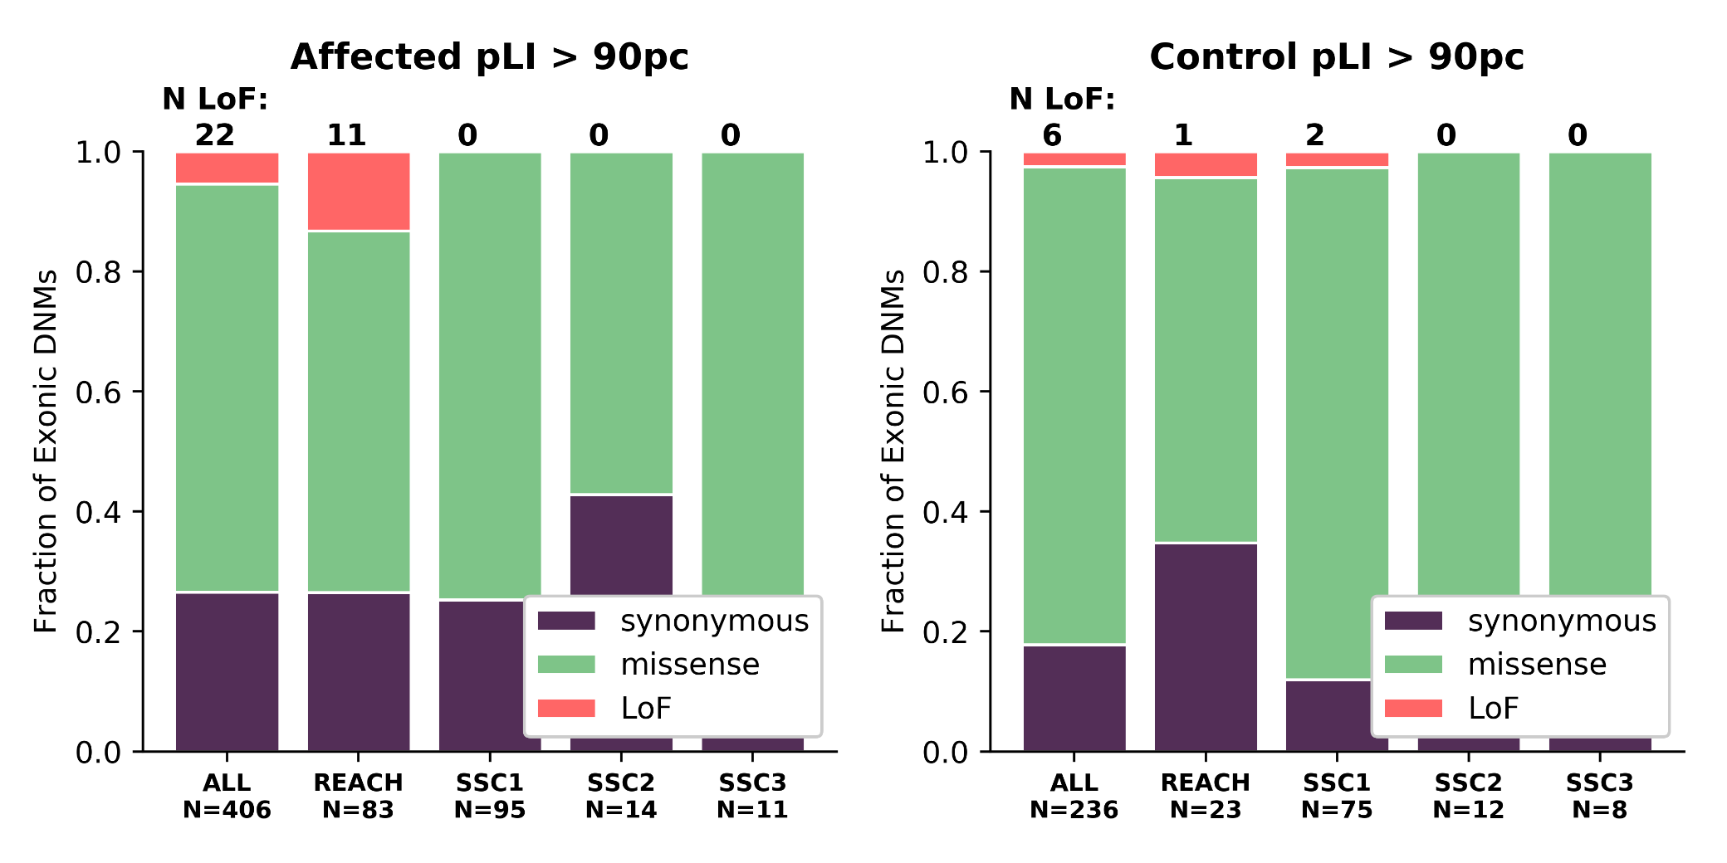
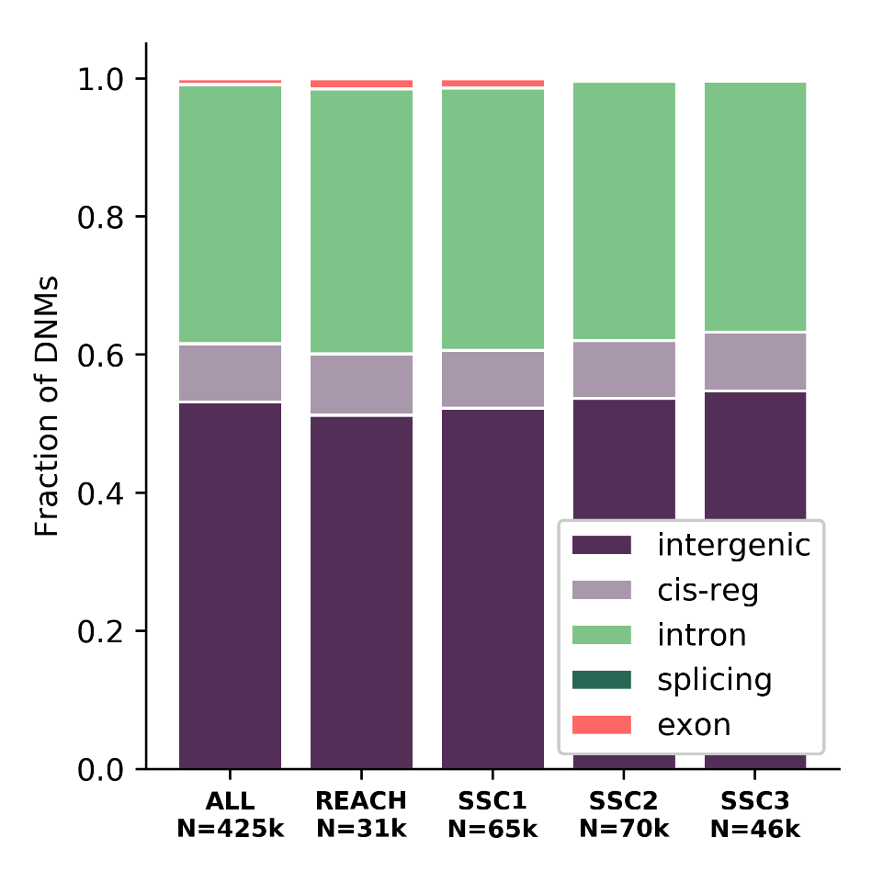
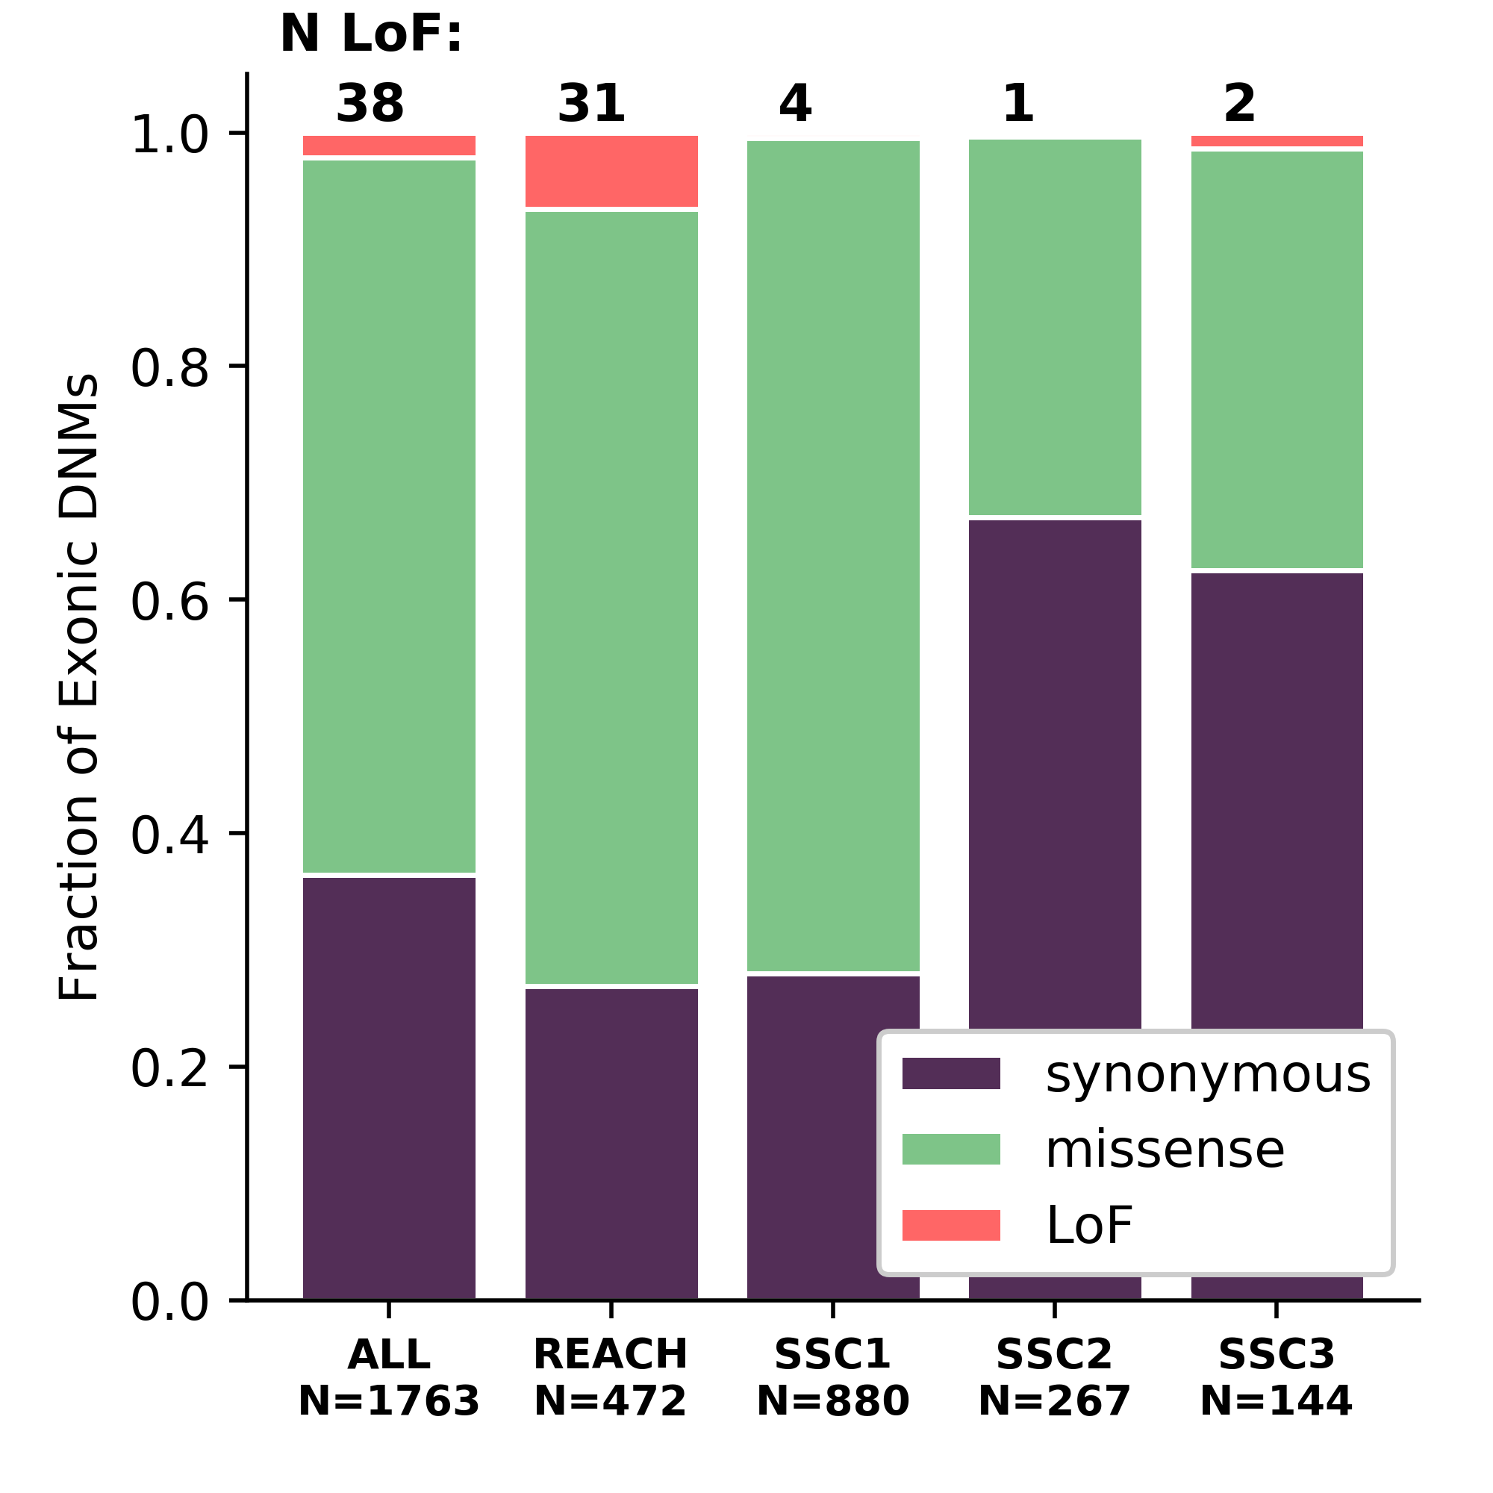
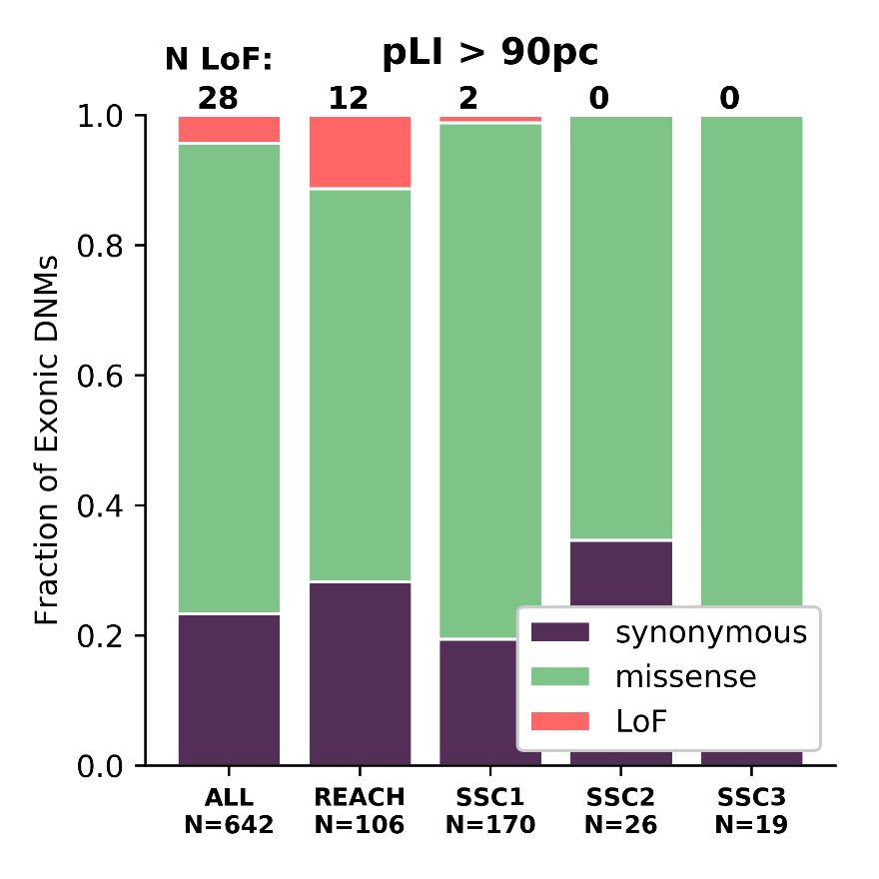
SSC samples are depleted for LoF de novo SNPs
de novo SNPs
Exonic de novo SNPs

Slide 34
De novo INDELs (Work in Progress)
Developing a machine learning classifier for de novo INDELs
Similar to ForestDNM
Training set: 11 pairs of MZ twins
True Positives: Inherited private variants genotyped in swapped parents
False Positives: Discordant de novos
Test set: 98 offspring
True Positives: Inherited private variants in swapped parents
False Positives: Apparent de novos
Validation set: 15 offspring
True Positives: Validated de novo INDELs in Single Molecule Reads
False Positives: WGS de novos not validated with long reads

Slide 35
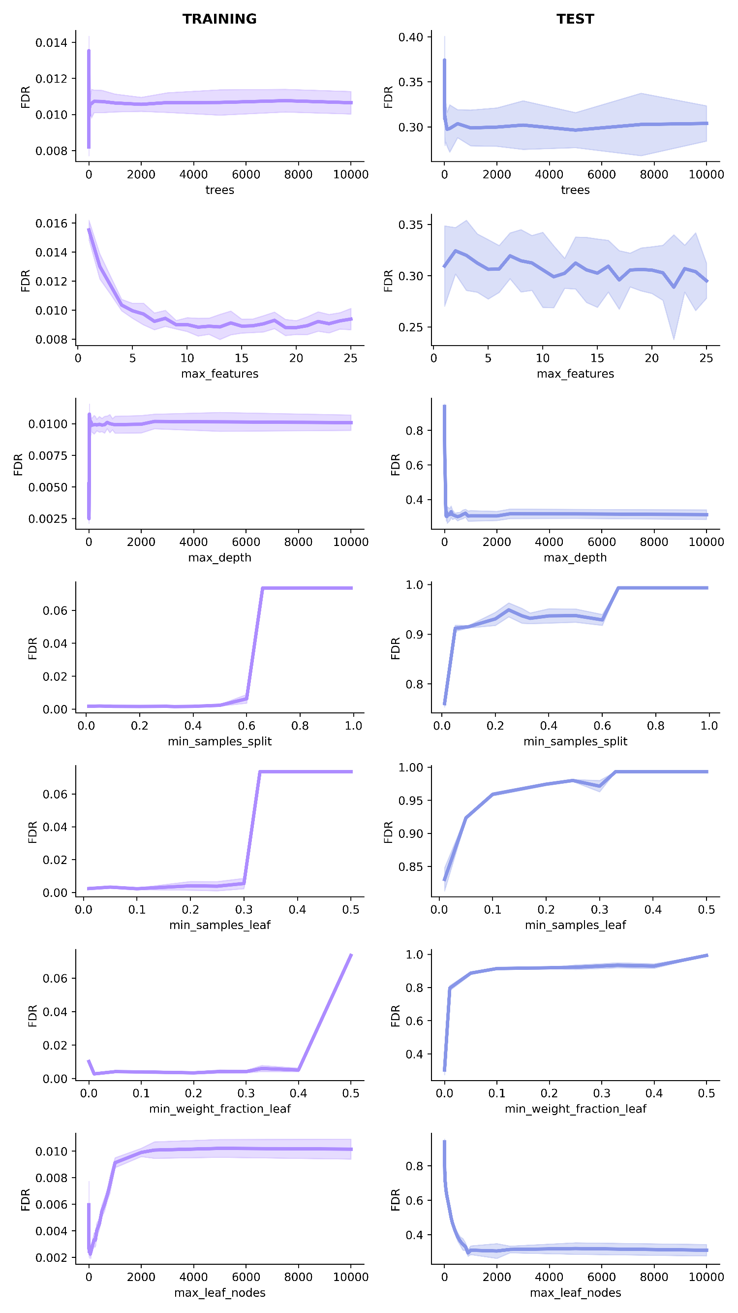
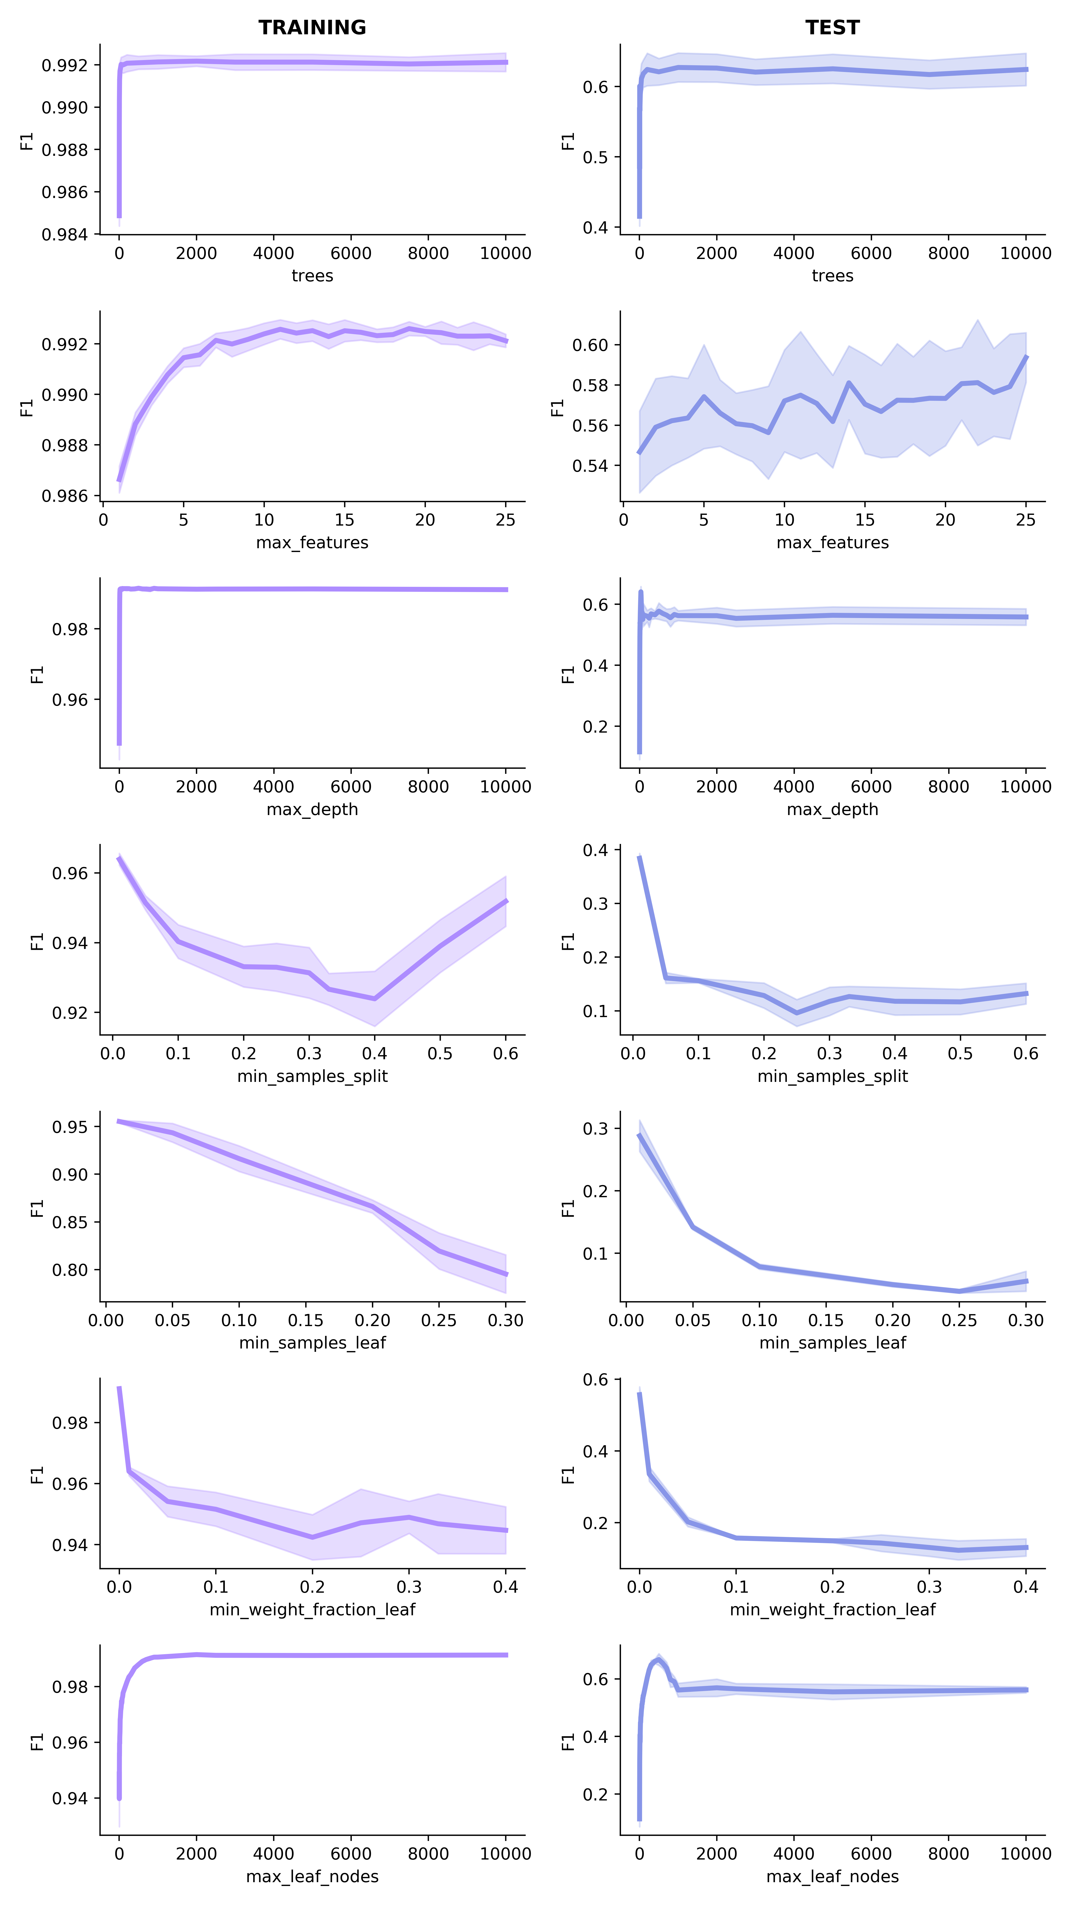
Initial Performance Results
10x cross validation
Parameter Sweeps
FDR below 2%
Grid Search
selecting the best parameters
Test set performance
Aojie Lian
Notes:
Harmonic mean of the precision and recall

Slide 36
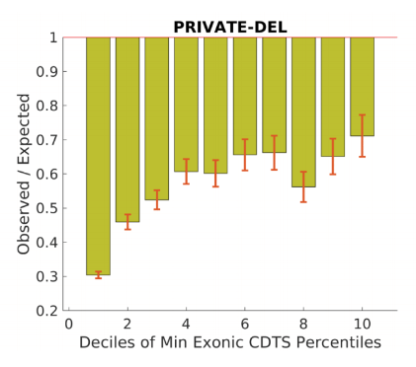
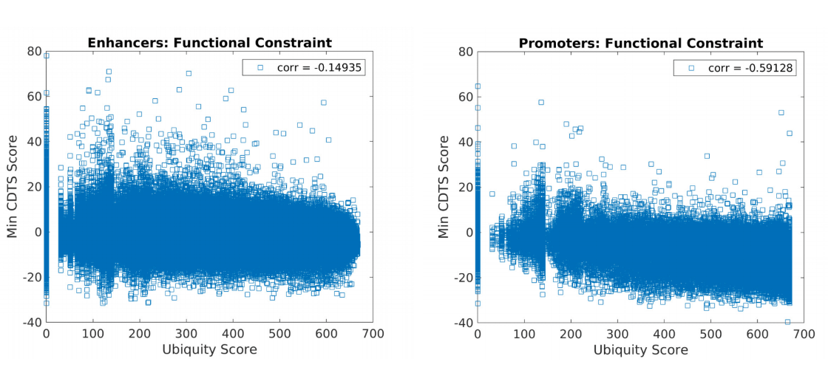
CDTS (Di Iulio J. 2018)
Prateek Tandon
Functional constraint score of the genome
10bp intervals
WGS SNP mutation
Private deletions are depleted in constrained regions
CDTS can help bin constrained cis-regulatory elements
Functional Constraint

Slide 37

Aim 3 Checklist
 | SNP | INDEL | SV
Variant Calling
De novo Annotation |  | Evaluating classifier | SSC2 + SSC3 need annotations
Private Variant Annotation |  |  | SSC2 + SSC3
TDT |  |  | Software framework only needs some adaptions
Conditioned TDT | Need to bin offspring by risk

Slide 38


Acknowledgements
Sebat Lab
William Brandler
Madhu Gujral
Prateek Tandon
Oanh Hong
Morgan Kleiber
Tim Chapman
Michelle Maile
Omar Shanta
Adam Koch
Aojie Lian
Stephen Scherer (MSSNG)
Rady Children’s Hospital
REACH project
Human Longevity Institute
Simons Simplex Project
1000 Genomes Project
San Diego Supercomputer Center
Thesis Committee
Jonathan Sebat: chair
Joseph Gleeson
Alysson Muotri
Abraham Palmer
Nicholas Schork
Funding:
NIH predoctoral training grant T32 GM008666 (UCSD Genetics Training Program)
Amazon Web Services Research Grant
Sebat Lab funding:
NIH: MH076431, MH113715
Beyster Family Foundation

Slide 39

Recurrent CRE-SVs
Gene | Cytoband | Annotation | Syndrome / ASD finding
CNTN4 | 3p26.3-p26.2 | Axon-assoc. cell adhesion molecule | 3p deletion/ASD CNV
RAF1 | 3p25.2 | Proto-oncogene, serine/threonine Kinase | Noonan/ASD CNV
MEST | 7q32.2 | hydrolase activity, paternally expressed | Silver-Russell /7q ASD susceptibility locus
LEO1 | 15q21.2 | Comp. of PAF1 complex, assoc. w/ RNA pol II | ./2 de novo LoF in ASD exome studies
CRE-SVs are significantly smaller than exonic SVs
Notes:
Example objectives
At the end of this lesson, you will be able to:
Save files to the team Web server.
Move files to different locations on the team Web server.
Share files on the team Web server.

